Slide 1
Metagenomics Data Analysis
Bioinformatics group
KACST

Slide 2
Outline:
Metagenomics definition & history.
Microbes.
Metagenomics Applications.
Metagenomics Data.
Metagenomics Analysis

Slide 3
What is Metagenomics ?
Metagenomics term was proposed by Jo Handelsman in 1998 during her work on the study of the antibiotic resistance.
Metagenomics is a non-culture based approach used to study of the collective genomes of the members of a microbial community that found in environment.

Slide 4
The Microbes Community:
The microbes are single-cell organisms.
The microbial community include viruses, bacteria and fungi.
The microbes community exist in soil, oceans, oil and animals gut etc..
Microbes are essential for every part of human life.
Microbes have a major role in maintain and regulate the atmosphere.
Microbes are important for human health.

Slide 5
Metagenomics Applications:
To describe microbial communities in different systems.
To study the taxonomy, phylogenetic and gene functions of the microbes in the environment.

Slide 6
Metagenomics and the Environment:
Microbes convert the key elements of life such as carbon, nitrogen & oxygen into forms accessible to all other organisms.
Microbes contribute in the photosynthetic.
Variety of microbes capable of living in extreme conditions environments.
Metagenomics allow us to identify unknown microbes and discover novel functional genes in these microbial communities.

Slide 7
Metagenomics and the Microbiota:
Human gut microbes involve in food digestion, break down toxins, and fight off diseases.
The interaction between the host organisms and the microbiota has a significant impact on their immune systems.
The changes in the compositions of the diversity of gut microbes will involve in many in Inflammatory bowel diseases, type 2 diabetes and colorectal cancer.

Slide 8
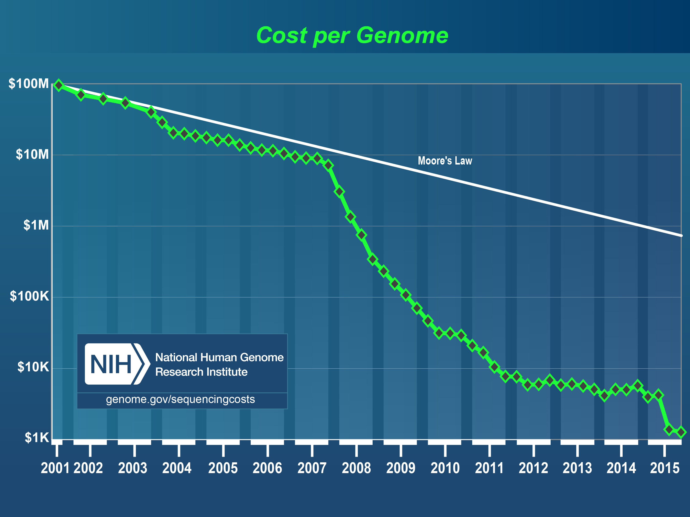
Genome cost:

Slide 9
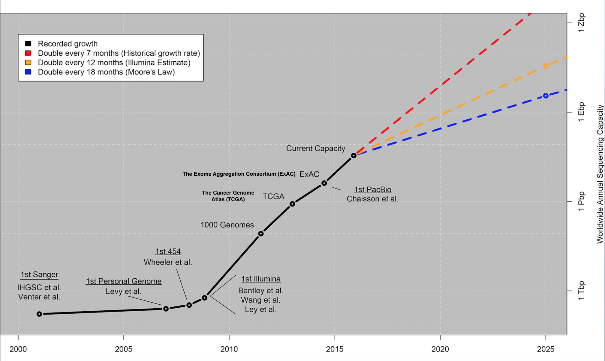
Genome Data:

Slide 10
Metagenomics Lab Workflow:
DNA Extraction
16s ribosomal RNA
Library
Whole genome shotgun
Library
Next Generation Sequencing (NGS)
Library preparation

Slide 11
Library Preparation:
 | 16s rRNA library | Whole genome shotgun library
price | 150 – 250 Saudi Riyal per sample | 1200 – 1500 Saudi Riyal per sample
Taxonomy level | Genus level | Species level
Applications | Taxonomic analysis Phylogenetic analysis | Taxonomic analysis, Phylogenetic analysis and functional analysis (Gene prediction & Biomarker discovery)

Slide 12
Library Preparation pros and cons:
Library Preparation | Advantages | disadvantages
16s rRNA library | Cheap Easy to do in the lab. Fast. | The taxonomy is limited to Genus level. Can not be used to study the functions of the genes. The classification of the data is less accurate. (clustering at 98%)
Whole genome shotgun library | Accurate classification. The taxonomy at the species level and sometimes Subspecies. Study the functional analysis . | High-cost. The lab work takes longer time. The assembly of the reads is super complicated and need to repeat the sample sequencing many times.

Slide 13
Metagenomics 16s rRNA Analysis Workflow:
Preprocessing
OTU Table Building
Alpha & Beta Diversity
Statistical analysis

Slide 14
Metagenomics 16s rRNA Analysis Pipelines:
Mothur Pipeline.
Qiime Pipeline.

Slide 15
Stage 1 - Preprocessing:
In this stage all reads will be checked for quality and will be trimmed if needed and the adaptors must be removed.
Quality check : Fastqc tool
Cutting Adaptors & Trimming : Cutadap tools.

Slide 16
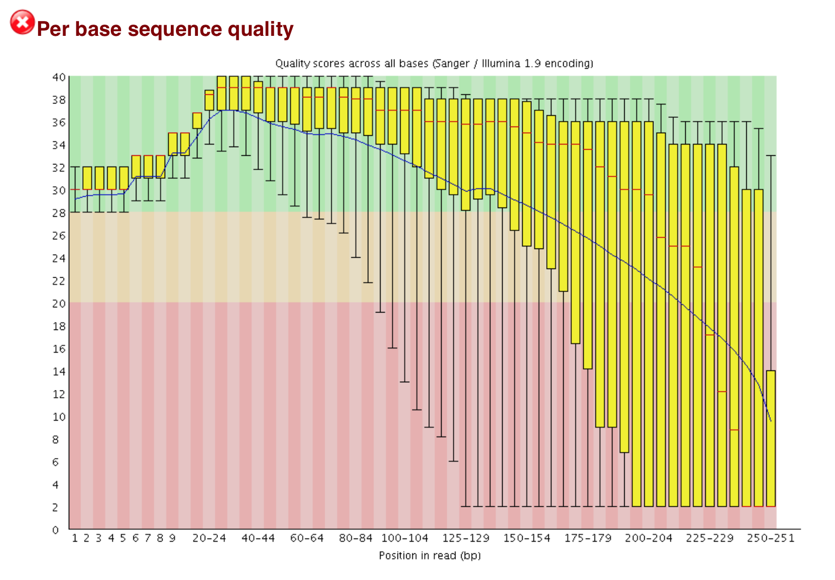
Before the preprocessing:

Slide 17
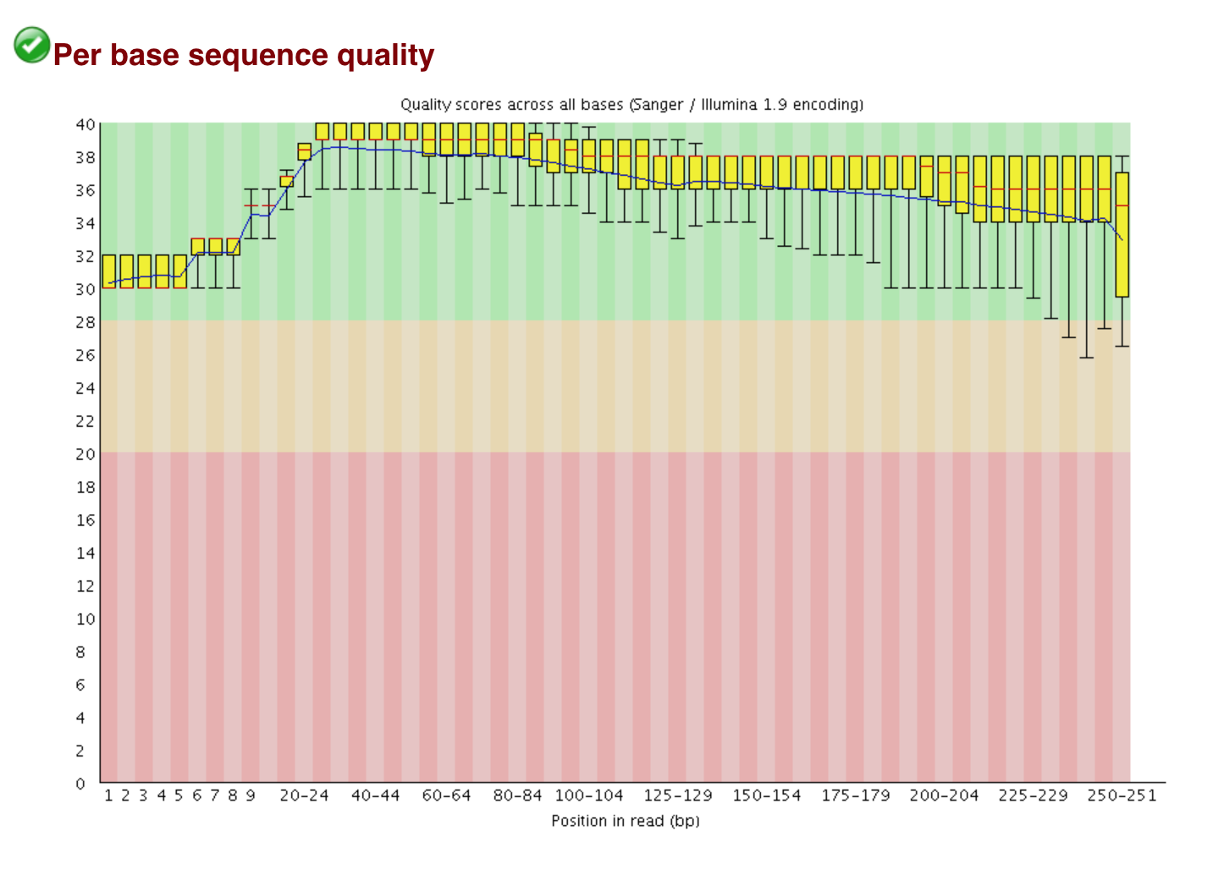
After the preprocessing:

Slide 18
Stage 2 – OTU Table Building:
OTU (Operational Taxonomic Unit) picking strategy:
De novo OTU Picking:
All reads will be clustered against each other without reference.
Reference OTU picking:
All reads will be clustered against reference sequence.
Closed Reference : Any reads that not match the reference sequence will be discarded.
Open Reference : Any reads that not match the reference sequence will be clustered as De novo.

Slide 19
Stage 2 – OTU Table Building:
After Picking the OTUS:
Assign taxonomy:
To identify the samples By using BLAST.
Sequence align:
To construct the phylogenetic tree.

Slide 20
Stage 3 – Alpha & Beta Diversity Analysis:
Alpha diversity analysis
To show the number of species or genus in one sample.
Beta diversity analysis
To show the number of species or genus that shared between samples.

Slide 21
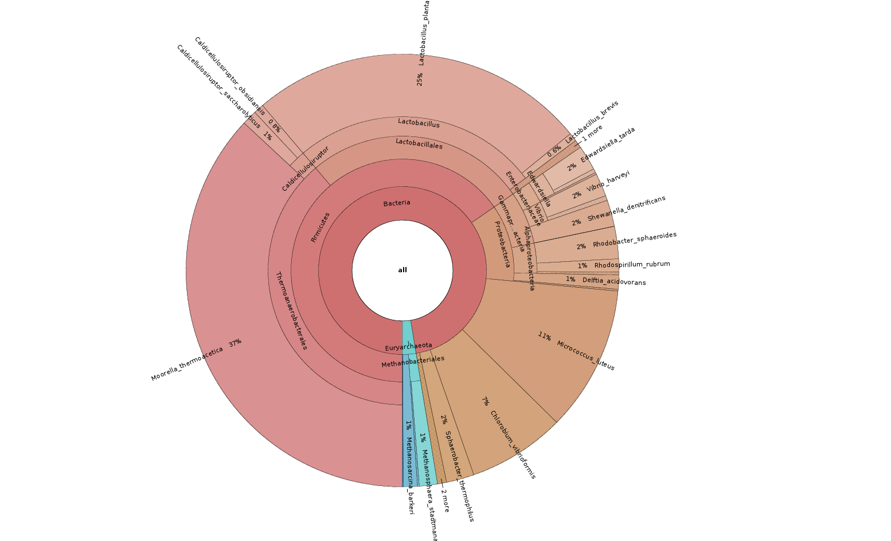
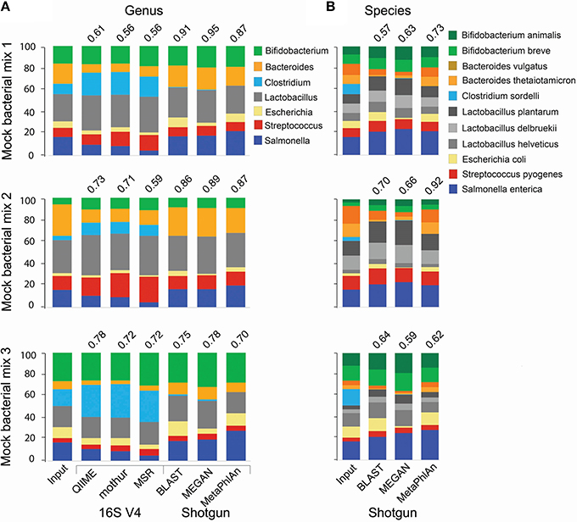
Stage 4 - Statistical analysis:
By using R language you can present you OUT table & Alpha & Beta Diversity Analysis results and in bar graphs, heat map or phylogenetic tree.

Slide 22
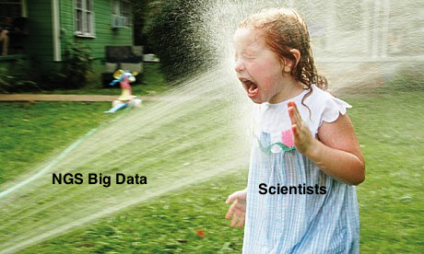
Thank you

